Slide 1
Hello
Notes:
no

Slide 2
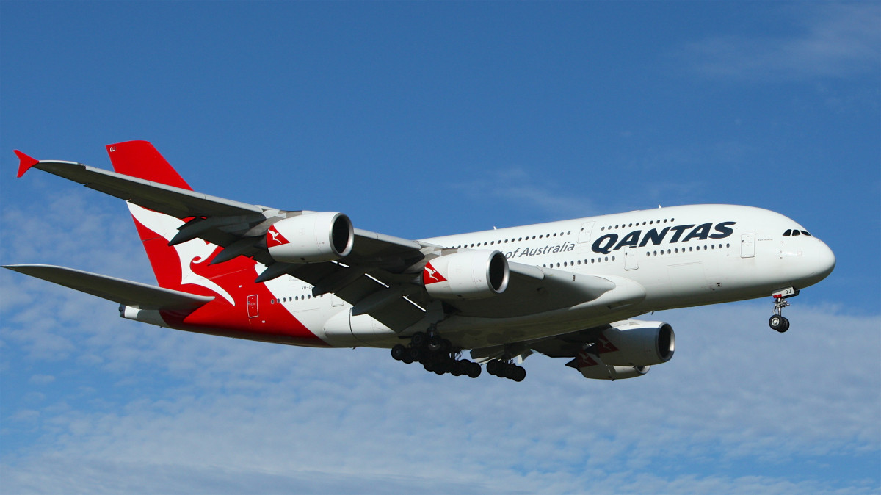
Hello
Notes:
no

